Slide 1







MSIM
Course Hub
Emily & Lavender

Slide 2



1
Information Story
Agenda
2
Existing Structure
3
FAIR Assessment: deficiencies and design improvements for your portable structure
4
New Structure
5
Data Quality & Security
6
DEMO!
7
Next Steps
Notes:
We'll start with our information story, talk how students use the current existing structure to find courses and make decisions. Then we'll go through how our project intersects with the FAIR principles, introduce our new structure, and go over quality, performance, and security requirements. We'll give a short demo of our website, and discuss next steps in the end.

Slide 3


Information Story
MSIM students try to find courses for the next quarter, but they have a hard time finding courses that actually support their learning and career goals.
Our improved system should allow users to search courses by career goal, filter by skill area, view student reviews, compare workload, and submit new course feedback.
Notes:
Our information story centers around our primary stakeholders which are MSIM students, who want to find courses to take for the next quarter that actually support their learning and career goals.
Our structure helps users access course information that they typically could only get through asking other students in the cohort and doing extensive research on their own using existing structures that have fragmented data.

Slide 4

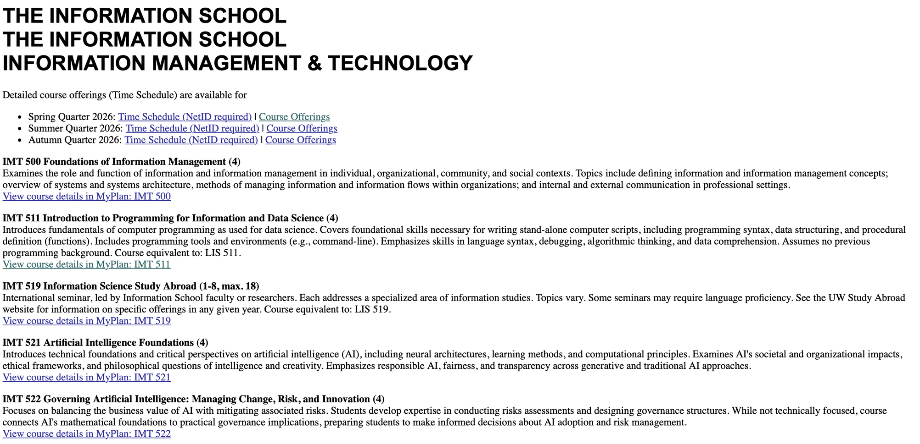
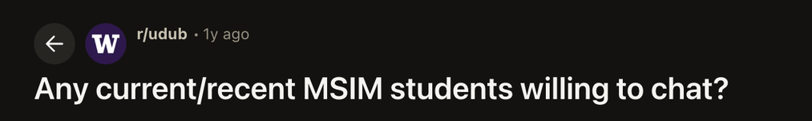



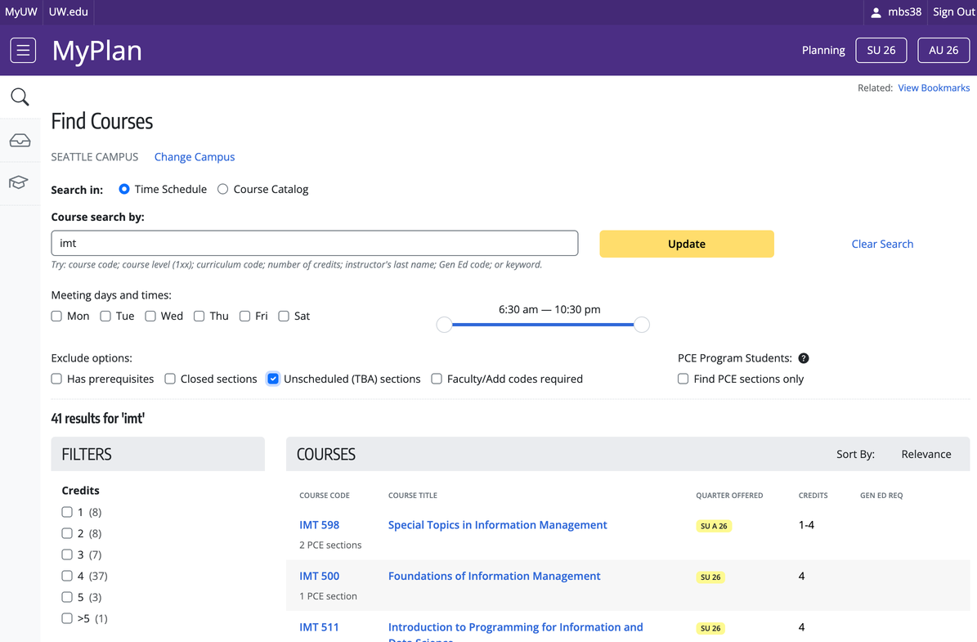
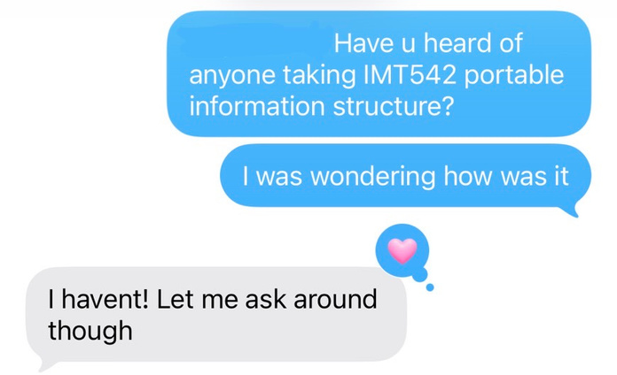
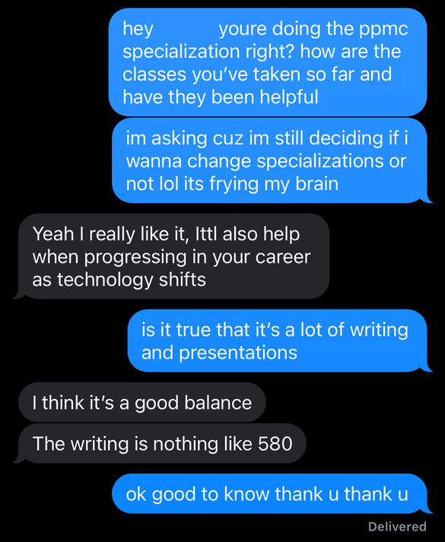
Existing Structure
Notes:
The existing structure includes multiple sources of information scattered around the
ischool time schedule
reddit threads
word of mouth and texting with friends
myplan course descriptions

Slide 5
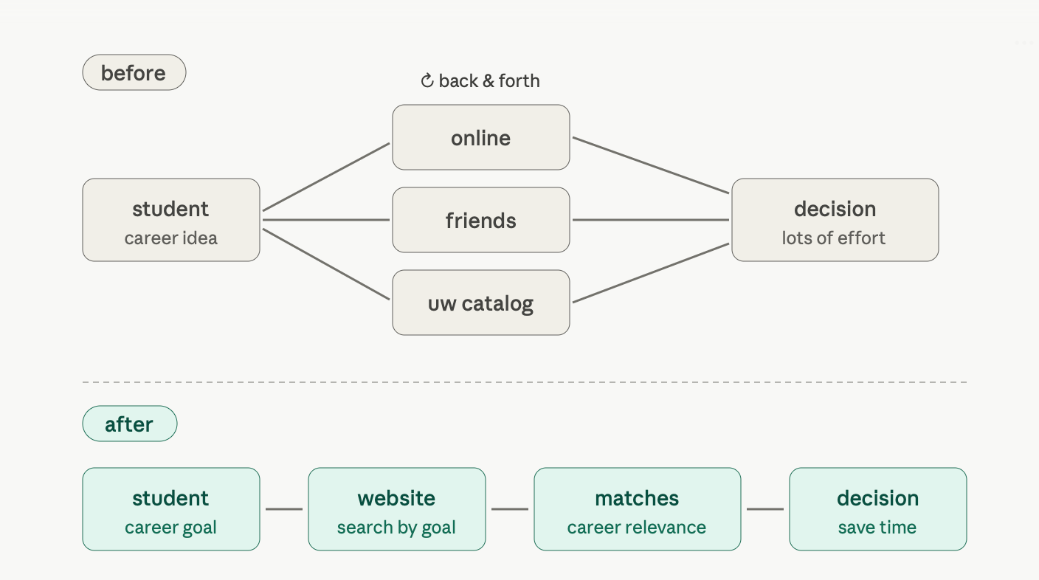
Workflow
Notes:
and here is a diagram showing how there's a lot of back and forth between online searches, asking friends, and browsing the uw catalogue before a decision can be made.
what we want is for students to get from their career idea to their course decisions faster.

Slide 6




FAIR
assessment
FINDABLE
ACCESSIBLE
Course IDs, names, descriptions, and metadata make courses easy to locate.
Course information and reviews are available through a web-based interface.
INTEROPERABLE
REUSABLE
Current limitation:
For now, our structure only supports data used in memory. Downloads contain the latest uploaded version and do not auto-update
Standardized vocab supports consistent integration of existing data and survey data across systems.
Course data can be downloaded as JSON for future reference and analysis.
Notes:
here are the areas of our improved structure that align with the FAIR guiding principles.
Findable
With findable, our improved structure aggregates all the course information under one course ID so all the relevant information is easy to locate
Accessible
Students access information through a web-based interface
Interoperable
Our tool allows users to input course reviews which will add to the existing data in the system.
Reusable
Students can download the course data as a JSON for future reference.
We do have a current technical limitation with the reusable principle. right now our structure only supports data used in memory, and that data needs to be manually updated. This is an area we hope to automate in the future.

Slide 7

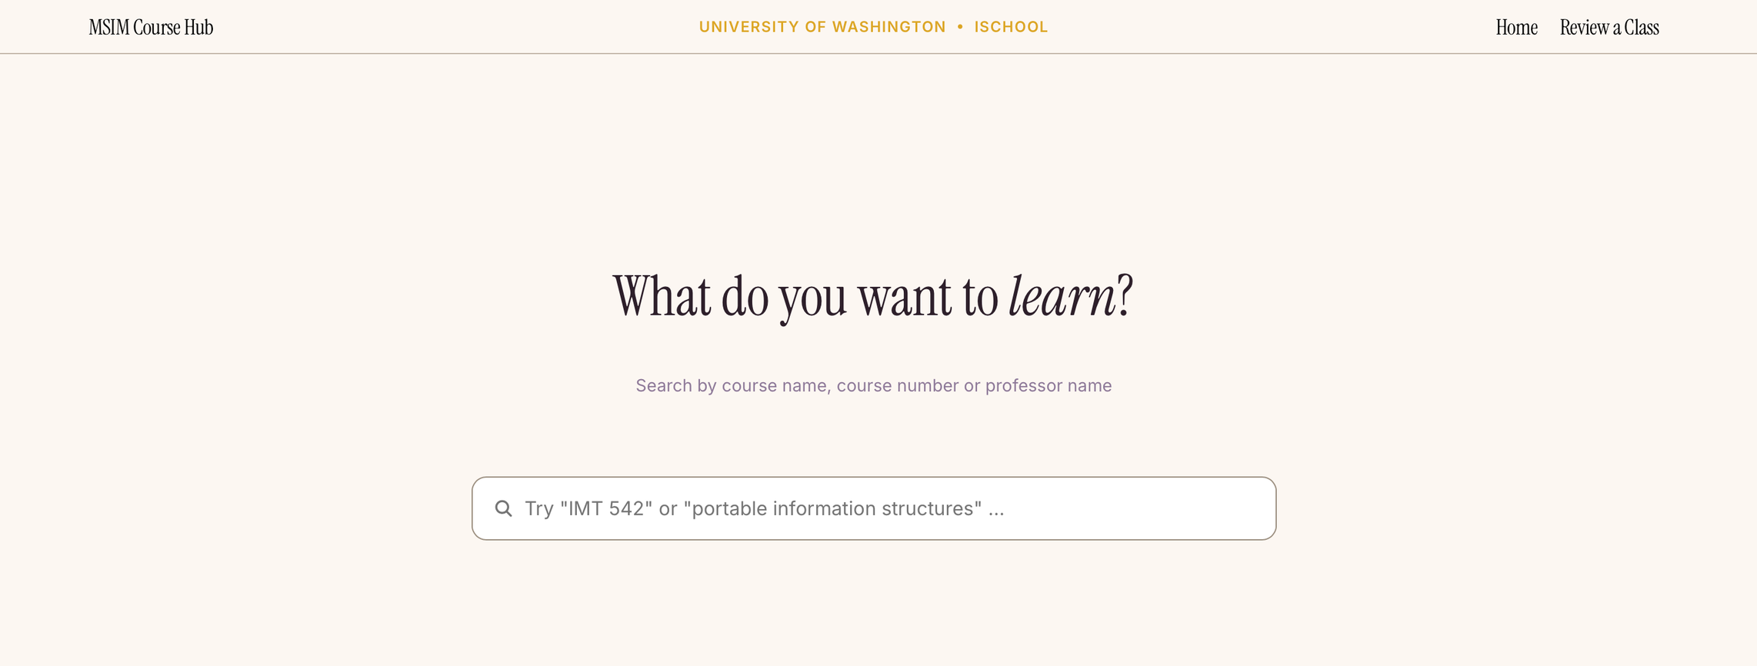

MSIM Course Hub

Slide 8
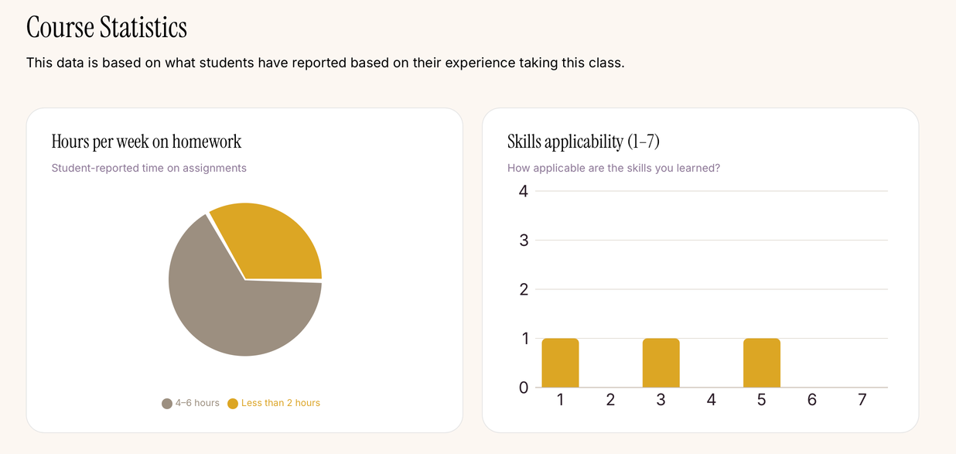
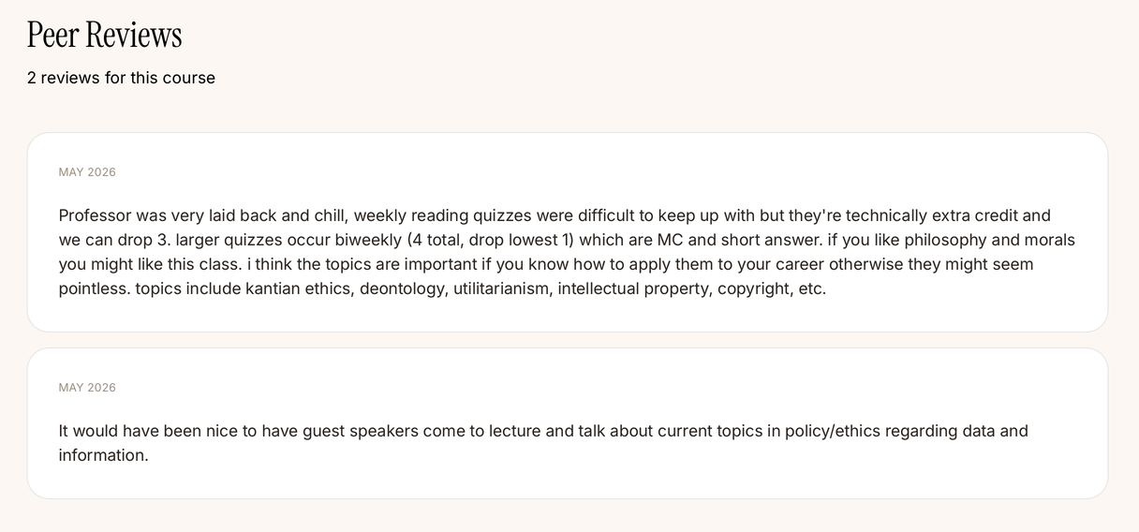
MSIM Course Hub

Slide 9





New Structure
Frontend: React + Vite
Backend: Flask API
In-memory data retrieval
Course Catalog Metadata
Student Review Submissions Data
Notes:
So here is our full-stack structure.
The frontend is built with React and Vite, which handles the user interface and search experience.
The backend is built with a Flask API. This layer connects the frontend to our data and handles requests from users, such as searching for a course or retrieving course details.
For the data layer, we use two main sources: course catalog metadata and student review data, and both store as json.
The course catalog gives us structured information such as course ID, title, credits, and so on. The student review data adds the student perspective, such as workload, skill applicability, , and additional insights.
So overall, the new structure makes the system easier to maintain and expand.

Slide 10
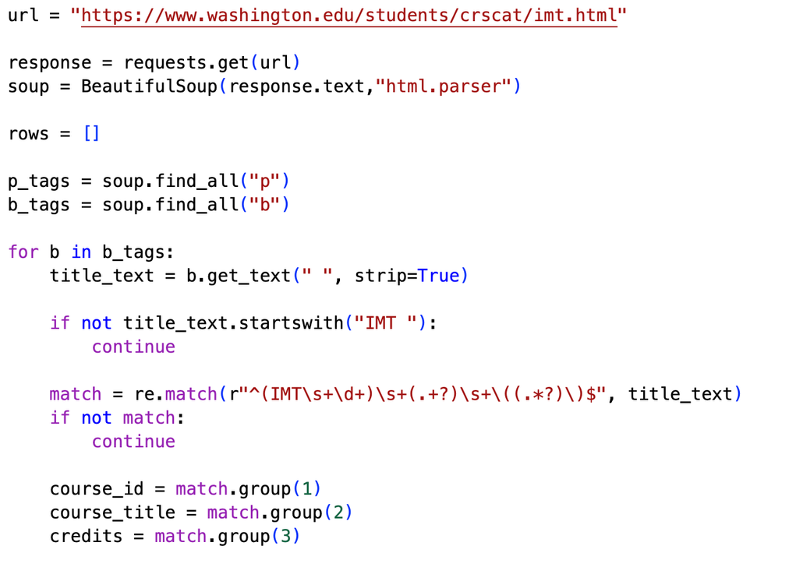
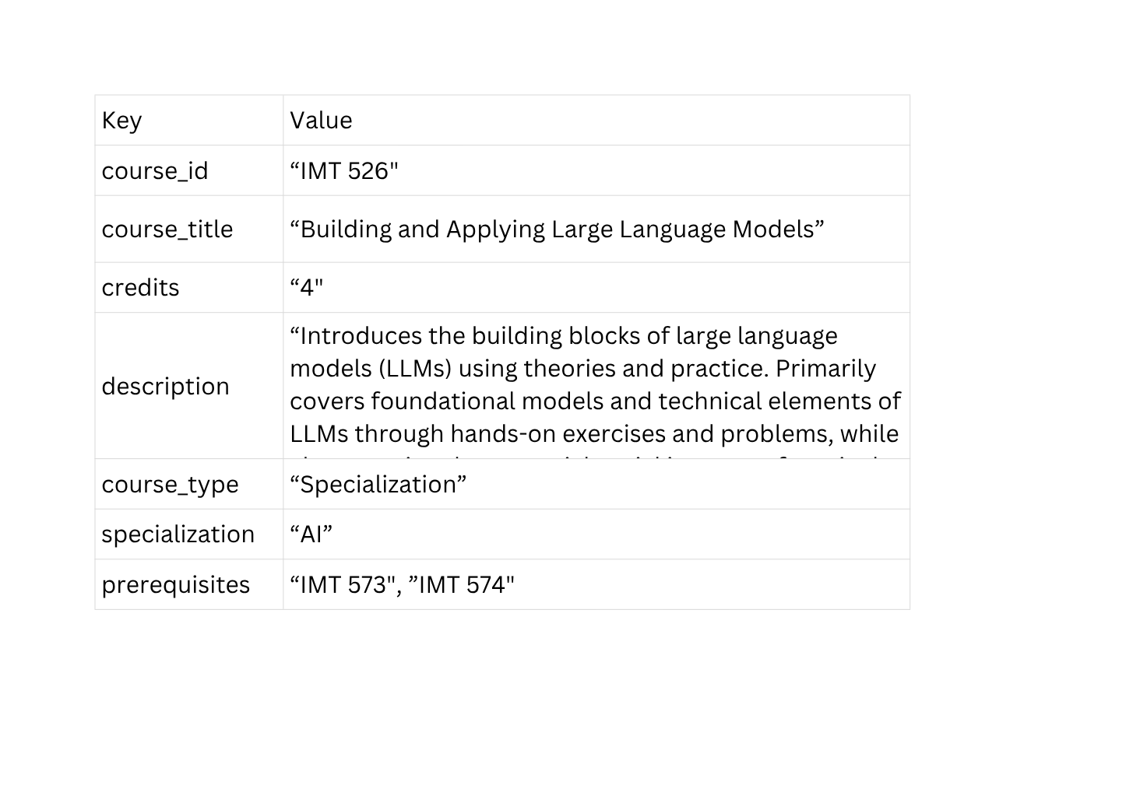
Data: Course Information
Notes:
For the backend, the first main dataset is the course information.
We collected them from the UW ischool course catalog page. The goal was to turn course information from a webpage into a structured format.
On the left side, this is an example of the Python scraping logic. We used BeautifulSoup to parse the HTML
On the right side, you can see the result after cleaning and structuring the data into JSON format. Each course becomes one object with fields.
This structure makes the course data easier to search, filter, and display in the frontend.
//
<b> tag = usually bold text. It may contain important labels, but it is mainly for formatting.
<p> tag = paragraph text. It may contain descriptions, but not all useful information is always inside <p>.

Slide 11
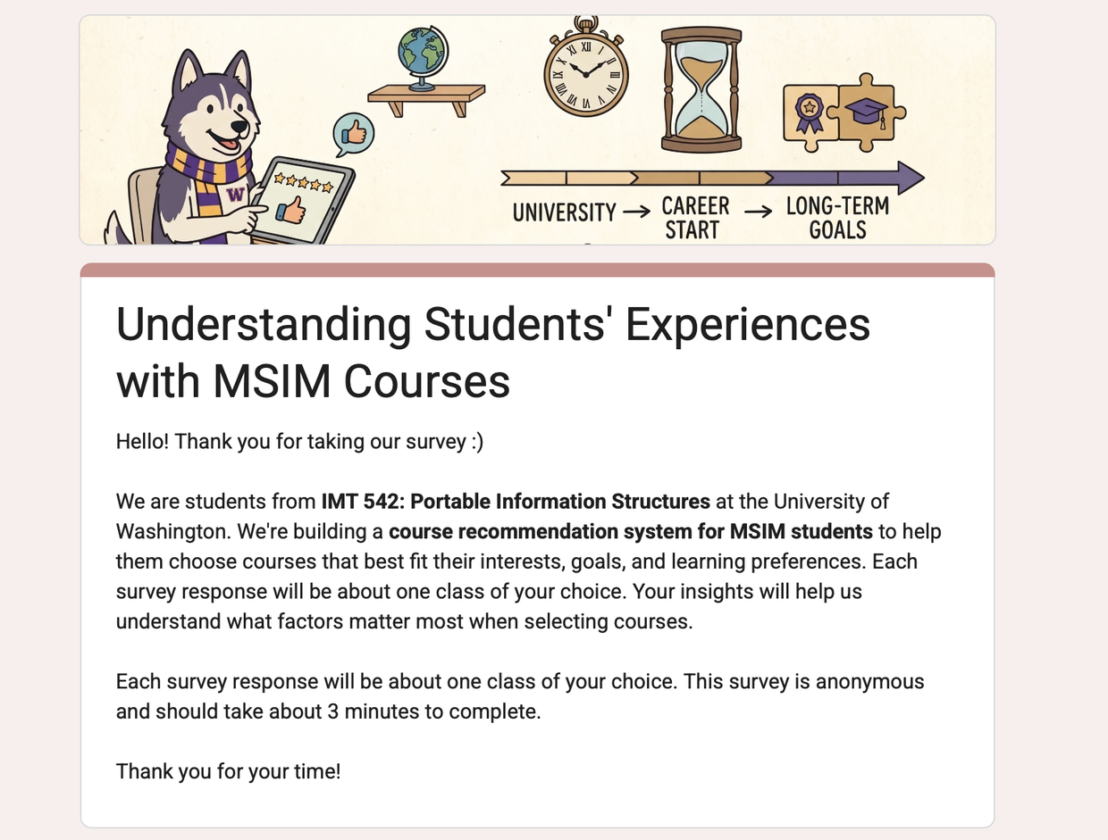
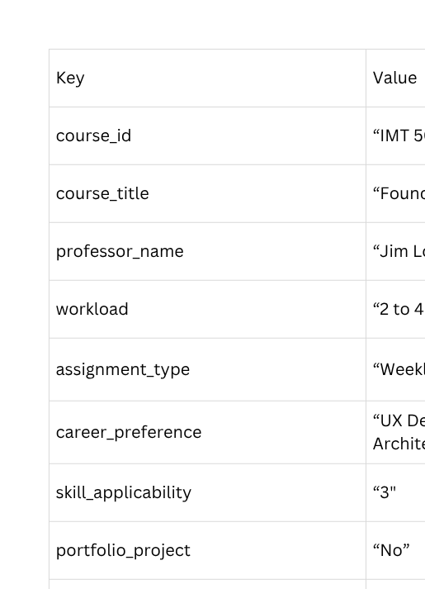
Data: Student Reviews
Notes:
The second dataset is the student review data.
We created a survey to collect student feedback about MSIM courses.
After collecting the responses, we converted them into structured JSON data as well. This allows each review to be connected back to a course.
By combining course catalog metadata with student review data, our system gives users both the official information and the peer perspective.

Slide 12
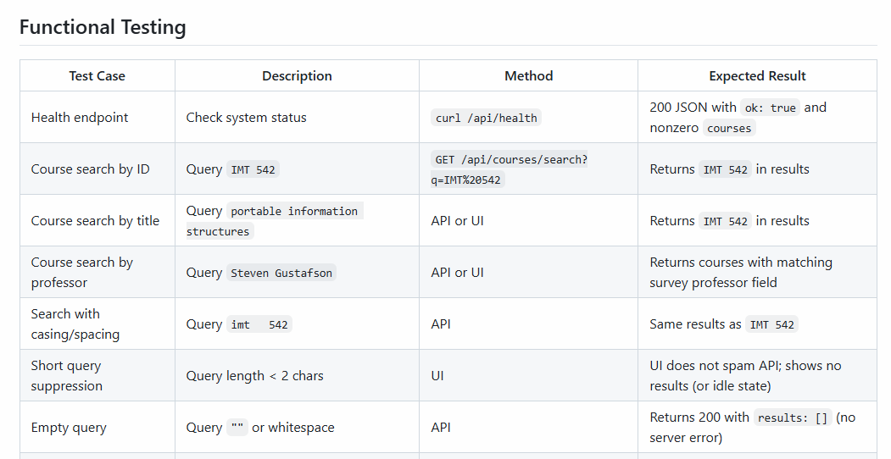



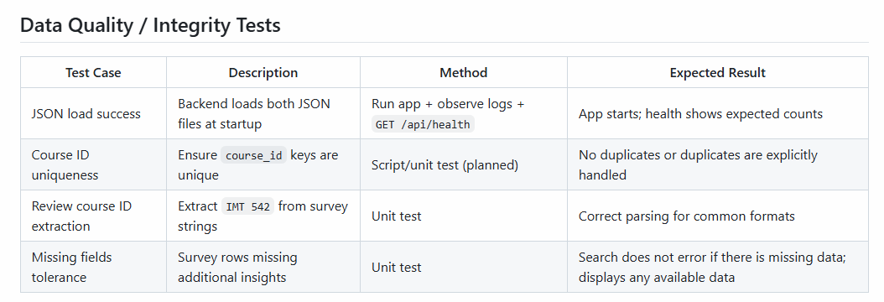
Data Quality
Notes:
I won’t go through every row in detail, but these two tables show our backend testing plan. We mainly focused on two areas: functional testing and data quality testing. For functional testing, we tested whether users can search by course ID, course title, and even different casing or spacing. This helps make sure the search experience still works even when users do not type the exact format.
For data quality, we checked whether the JSON files load correctly, whether course IDs are unique, and whether reviews can be connected to the right course. We also considered missing fields, since some optional survey questions may be left blank. The goal is to make sure the system can still display the available data instead of breaking.

Slide 13


Identity Management
UW email login is required
Data Privacy
Course feedback remains anonymous
Access Control
and
User Privacy
Notes:
Besides testing functionality and data quality, we also considered basic access control and privacy. Since this system is designed specifically for UW students, users should log in with their UW email. This helps make sure the feedback comes from the target user group.
At the same time, responses remain anonymous, so students can feel comfortable sharing honest course feedback.

Slide 14





Demo

Slide 15

Next Steps
Use open-ended feedback to support keyword search and course recommendations
Develop a database to store the existing data
and future reviews
Store reviews in a database that updates automatically when users submit reviews
Notes:
1. we want students to be able to ask questions in plain language as well as have their open-ended feedback better support the course recommended
2. We want to develop our databases further to better store the existing data and student reviews
3. We want to automate the system so that when new reviews get added to the database they are immediately accessible through searches.

Slide 16
Thank you!

